Slide 1

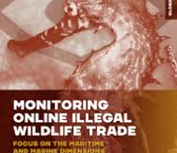

The Digital Transformation of Wildlife Trafficking: A New Frontier in TOC
Gohar A. Petrossian, Ph.D.
September 25, 2025
Prepared for the UNGA 80 Side Event: TOC: New Threats, New Responses

Slide 2

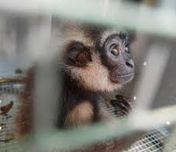

01.
Setting the Stage: Wildlife Crime and TOC

Slide 3
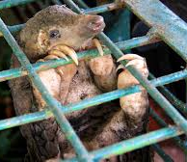
Setting the Stage
Scale and Scope
Wildlife crime estimates (US$7-$23 billion), excluding fish and timber
~4,000 species, ~163 countries, ~13 million specimens seized between 2015-2021 (UNODC, 2024)
Complex supply chain of actors

Slide 4
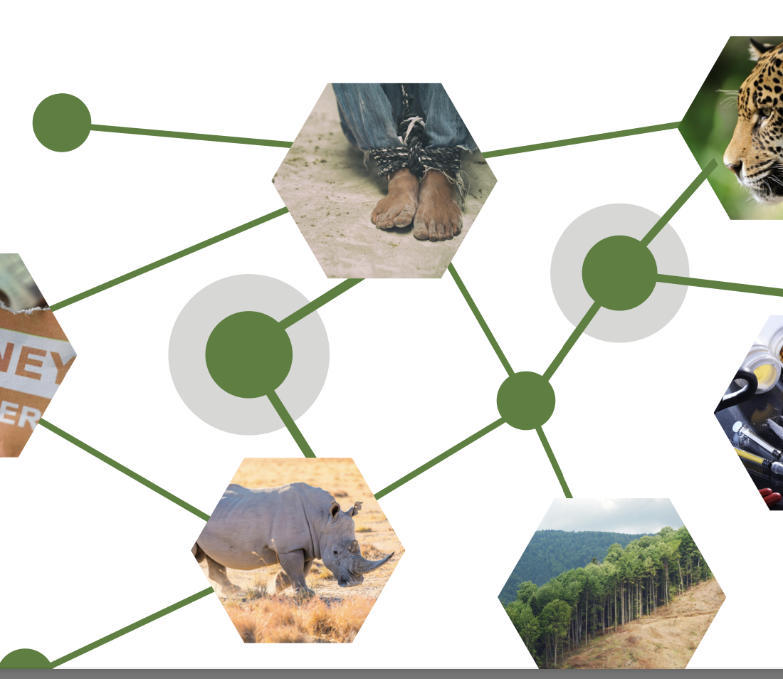
Convergence with Other Serious Crimes
Networked TOC ecosystem
Wildlife crime is embedded within broader organized crime ecosystems
Convergence Paradigms (ELI & John Jay, 2023)
Multi-species
Multi-environmental crimes
Serious-crimes
Transnational networks

Slide 5
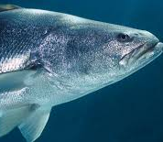
Security Implications
Wildlife Crime is a “threat multiplier”
Fuels corruption and weakens border security
Undermines state legitimacy
Empowers criminal actors
Finances violence
The Critically-Endangered Totoaba
Sinaloa cartel
Cartel Jalisco Nueva Generación

Slide 6



Cyber-Enabled Wildlife Crime
02.

Slide 7
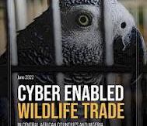

The Digital Shift
The internet as a global marketplace
COVID-19 and the shift from physical to online marketplaces
A staggering range of species
E.g. AquaBid – ornamental fish, live animals, fish eggs, plants (Olden et al, 2021)
Raptors (Nijman et al, 2022)
Spiny-tailed lizards (Gondhali & Petrossian, 2023)

Slide 8
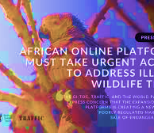
Where Wildlife Trade Thrives Online
Wildlife online sales are not ‘dark’
Clear/surface web
E-commerce sites (eBay, Etsy, Craigslist, Gumtree) – reptile leather, ivory, live animals
Social Media (Facebook, Instagram, TikTok)- live birds, mammals, sun bears, exotic pets, big cats.
Messaging/Encrypted Apps (WhatsApp, WeChat, Telegram)

Slide 9
Case Study: 1
Scaling the Web: Unraveling Online Reptile Leather Trade Networks with Machine Learning and Network Analysis
Petrossian et al (under review)
Target: small leather products made from CITES-protected reptile species
Time frame: 1 month
Total relevant listings on eBay: 20,741

Slide 10
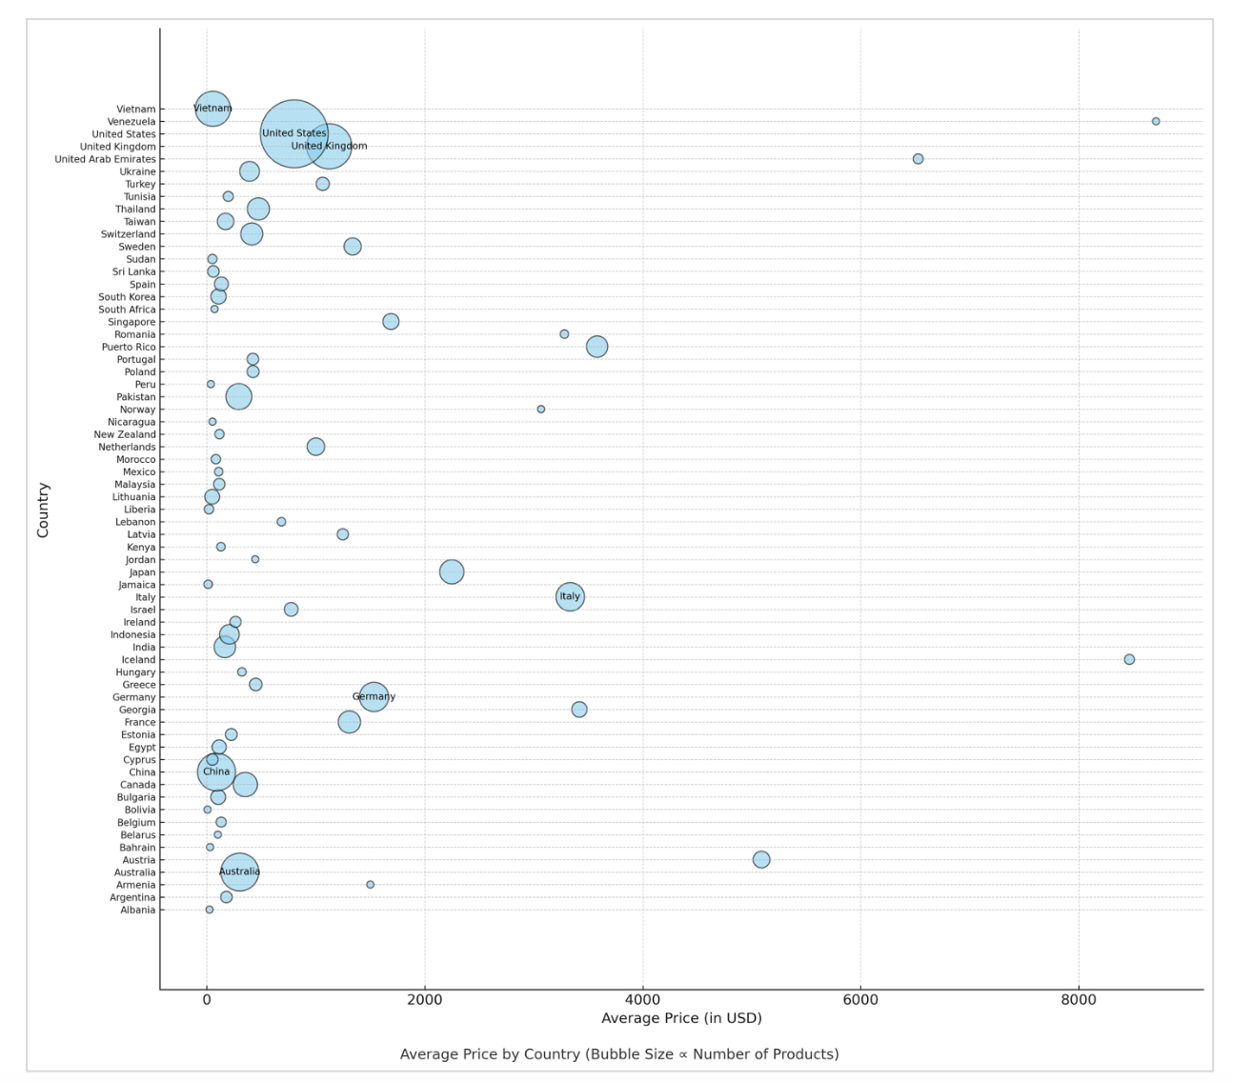
65 countries
Top 5 countries -86% of listings (US, UK, Australia, China, Viet Nam)

Slide 11
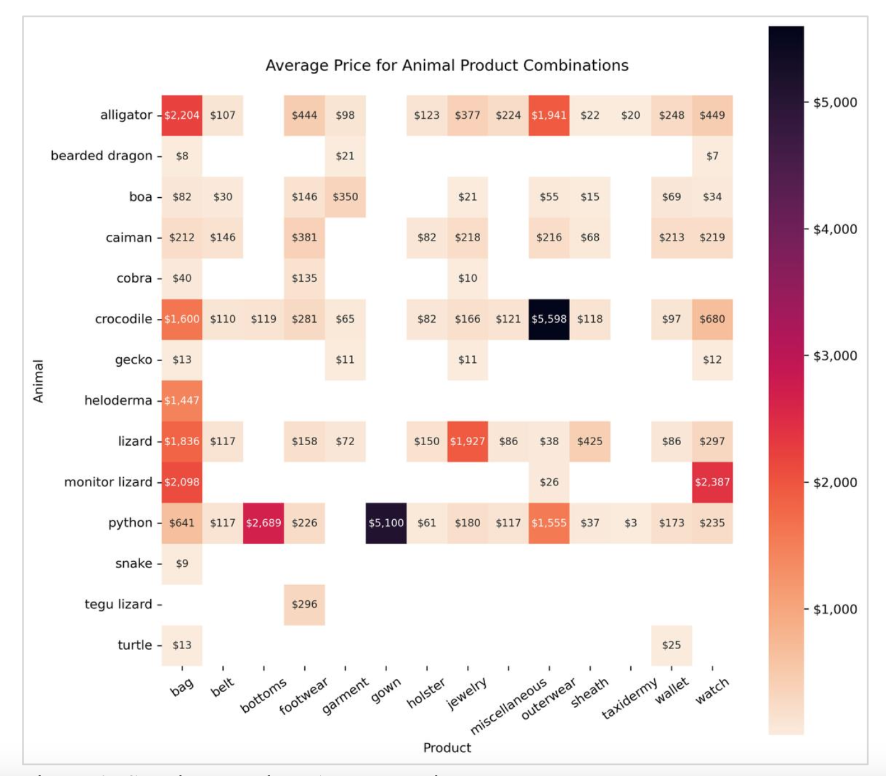
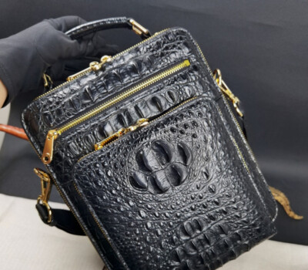
Alligator bags accounted for the highest gross income (US$3.4 million), with the average price of $2,204.

Slide 12
A Closer Look at Online Seller Profiles
Lavorgna (2015)
Target market: Cyber-enabled pet trafficking businesses
Emerging types of sellers: (1) individual offenders, (2) partners, (3) loose networks, (4) structured networks
Dominguez (2024)
Target market: reptiles
Seller typologies: (1) organized traders, (2) professional online traders, (3) private traders
Highly organized and profit-oriented, traded multiple species
Petrossian et al (under review)
Target market: small leather products
Seller typologies: (1) low profile, (2) moderate visibility; (3) luxury/high visibility; (4) fully professional; (5) luxury without exclusivity
Differ by visibility, professionalism, market position

Slide 13
Disrupting Cyber-Enabled Wildlife Crime
03.

Slide 14


The Digital Ecosystem and Responding to Cyber-Enabled Wildlife Crime
Traditional enforcement does not translate easily into the digital arena
Online trade is fast-moving, decentralized, resilient, and fragmented, making it harder to trace transactions
Encrypted apps and payment systems make it easy for online transactions to go undetected

Slide 15
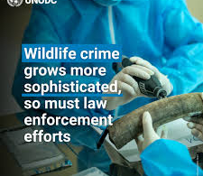
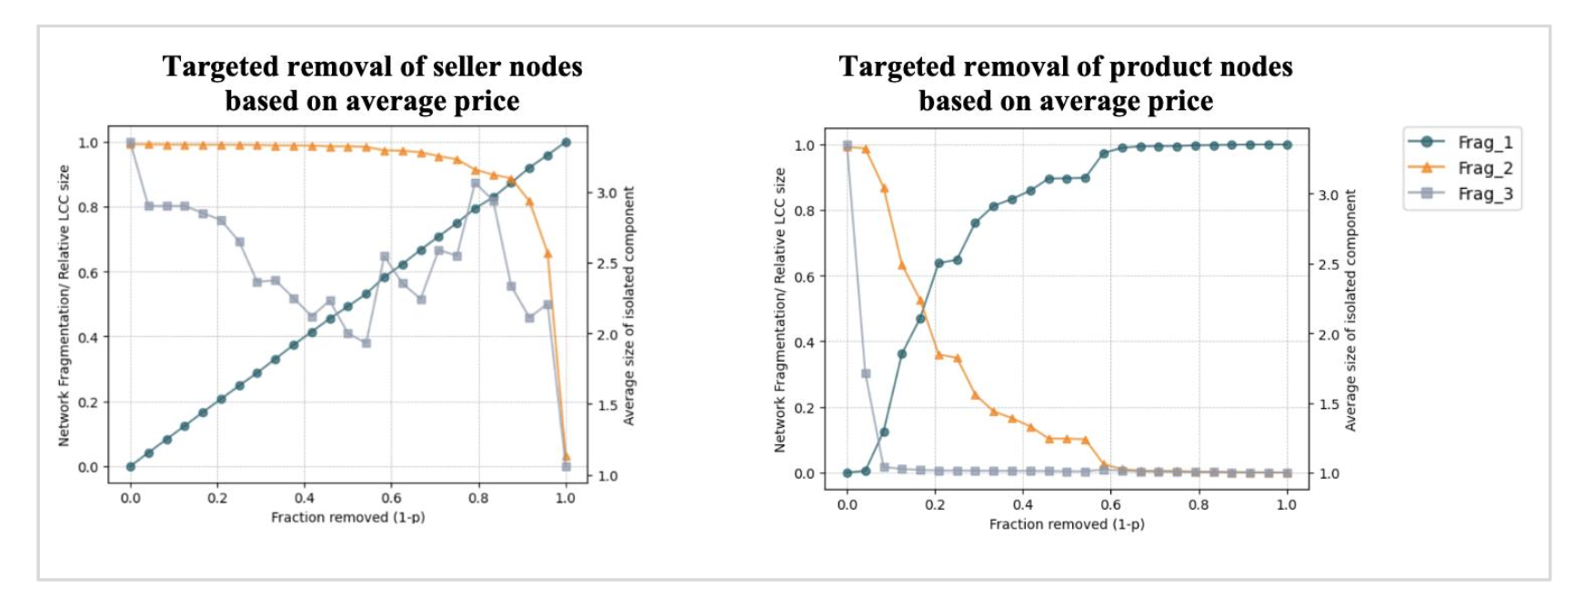
A Key Shift in Prevention Approach
New digital environment requires proactive disruption
Network Percolation Analysis as a promising disruption/analytical tool
Networks highly robust against random removals of seller nodes
Random removal of product nodes led to graduate fragmentation of the network
Targeted removal of sellers can cause abrupt network collapse but it is impractical
Targeted removal of products (especially by weight and degree), is the most effective strategy of network fragmentation

Slide 16

International Tools for Disruption
International Tools for Disruption
UNTOC (Palermo Convention) → backbone against transnational organized crime
Environmental crimes under UNTOC
Historically underused → now gaining traction
Expert Group on Crimes that Affect the Environment established

Slide 17

04. CONCLUSION
Wildlife crime is transnational organized crime
There is a significant digital shift
Empirically-driven research insights should inform policy
Policy and enforcement must adapt
UNTOC is a critical lever for action

